Slide 1
EasyShopping
FINAL PROJECT – A FULL-FLEDGED SHOPPING LIST
SHOBHIT SHARMA

Slide 2
INTRODUCTION
Brief Overview of the App and Its Purpose:
The Shopping List App helps users manage their shopping tasks efficiently by allowing them to create, view, edit, and delete shopping items.
Ensures data persistence, cross-device synchronization, and real-time updates for seamless shopping list management.
Key Features and Functionality:
Intuitive Complex UI built with Jetpack Compose.
Offline data storage using Room Database.
Real-time synchronization with a backend using Retrofit (REST API).
Automatic data sync on connectivity changes via Broadcast Receivers.

Slide 3
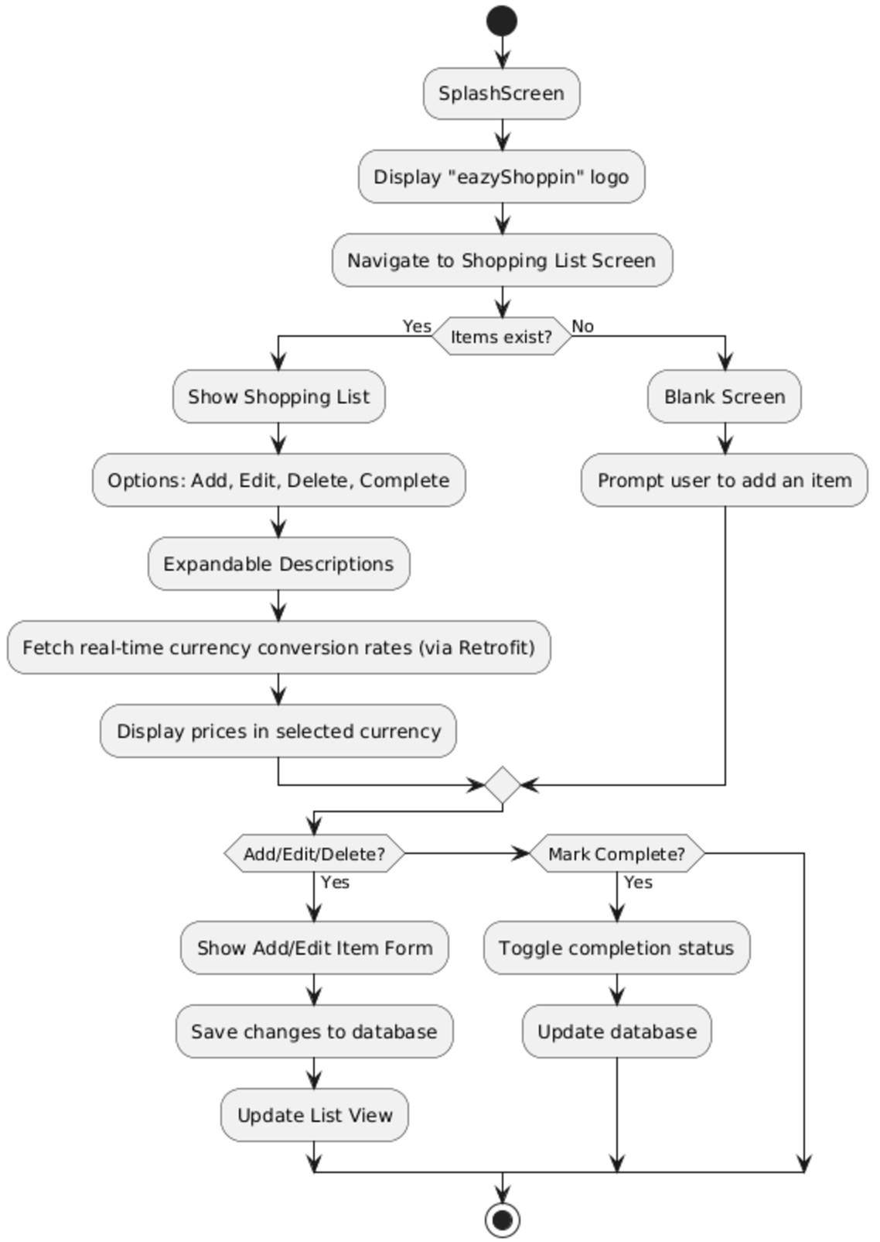
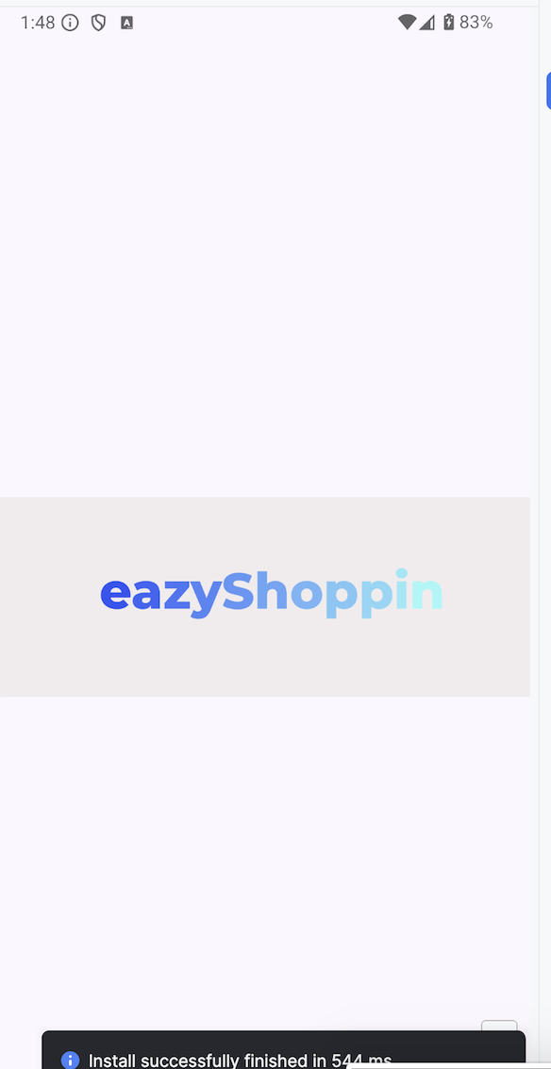
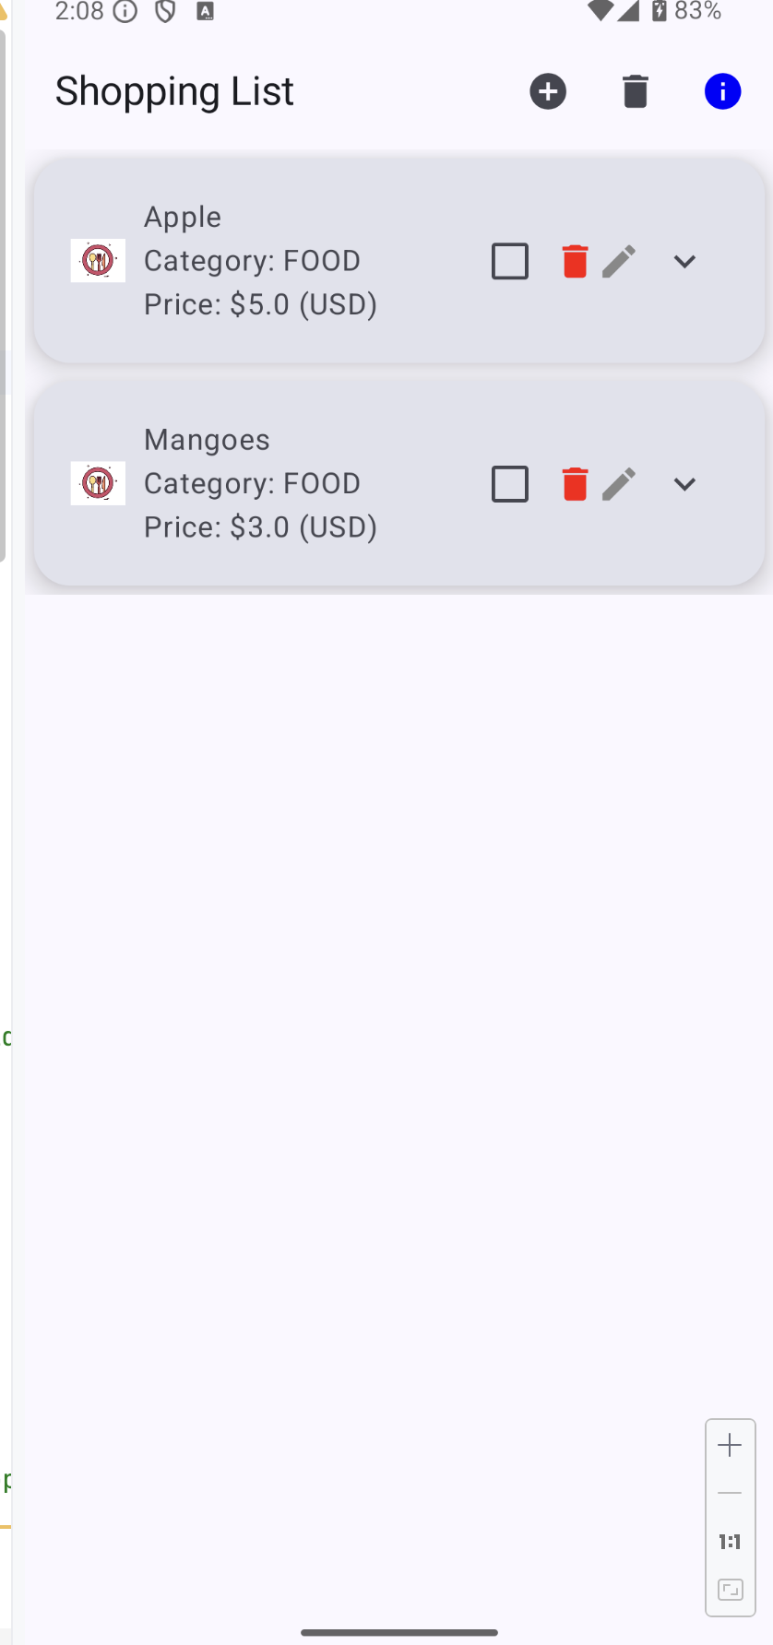
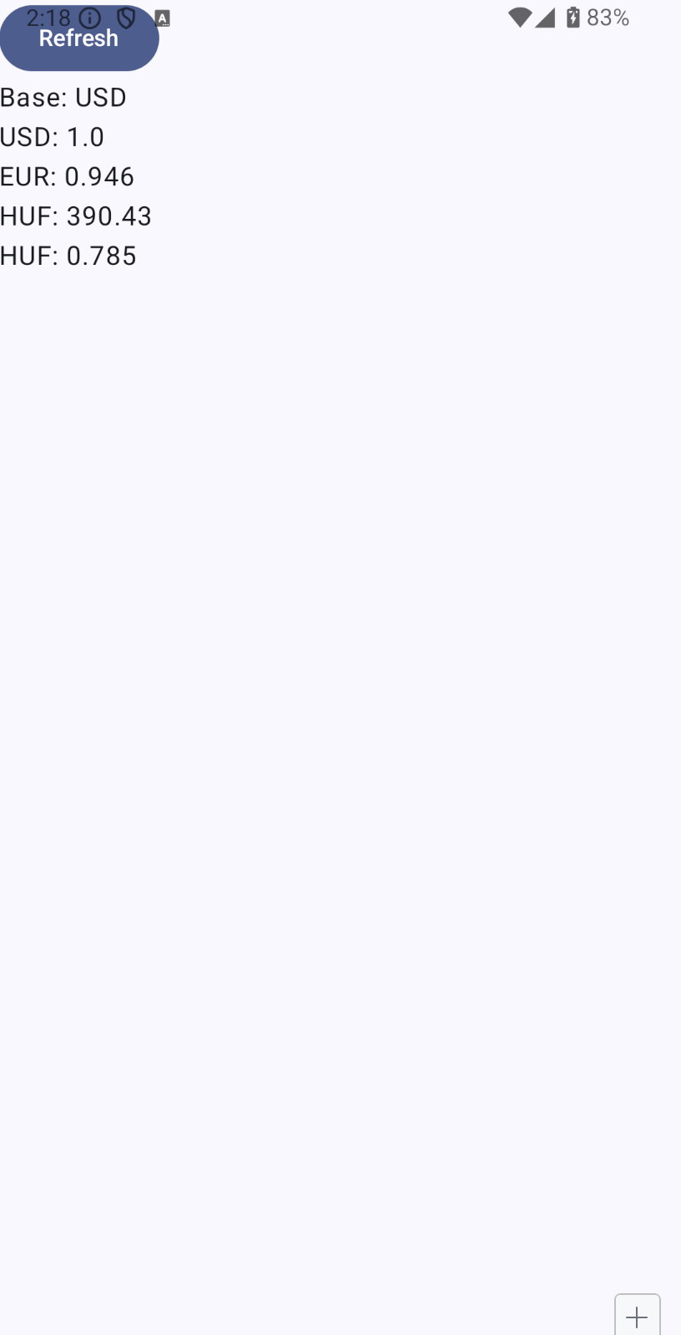
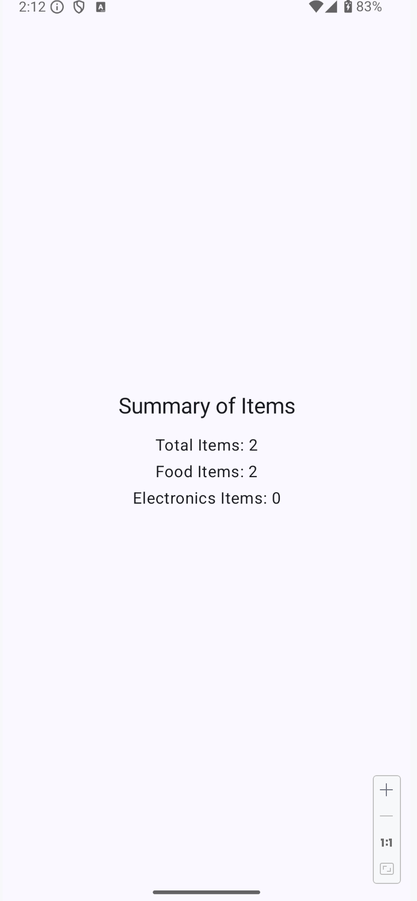
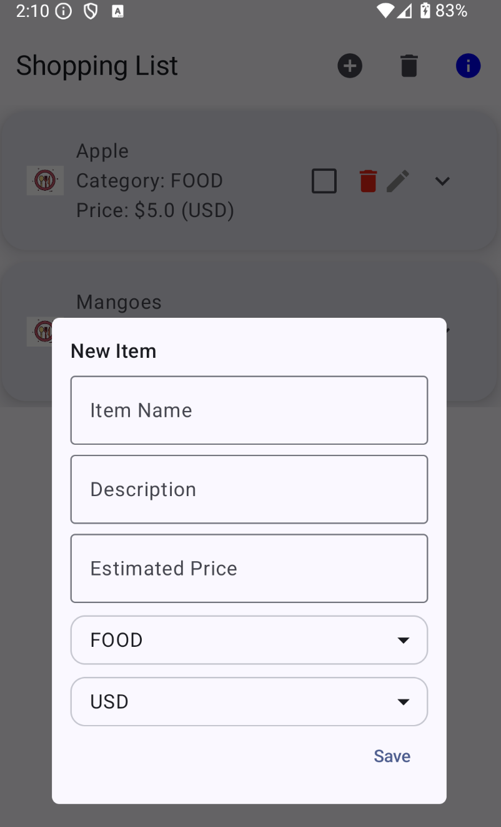

Slide 4
Main Technologies
Jetpack Compose: Modern, declarative UI framework for creating complex and responsive UIs.
Room Database: Local persistence for offline access to shopping list data.
Retrofit: REST API integration for syncing shopping list data with the backend.
Broadcast Receivers: Listens for system-wide events such as network connectivity changes.
Synchronizes offline data with the server when connectivity is restored.
Enhances reliability in real-world scenarios.

Slide 5
Key Features
Item Management:
Add, modify, delete, and mark items as completed.
Expandable descriptions for each item.
Persistent Storage:
Offline data storage using Room Database for seamless access.
API Integration:
Real-time currency conversion rates fetched using Retrofit.
Synchronization of data with a REST API.
Broadcast Receivers monitor network changes and trigger automatic data synchronization.
For Charging
For Network Connectivity

Slide 6
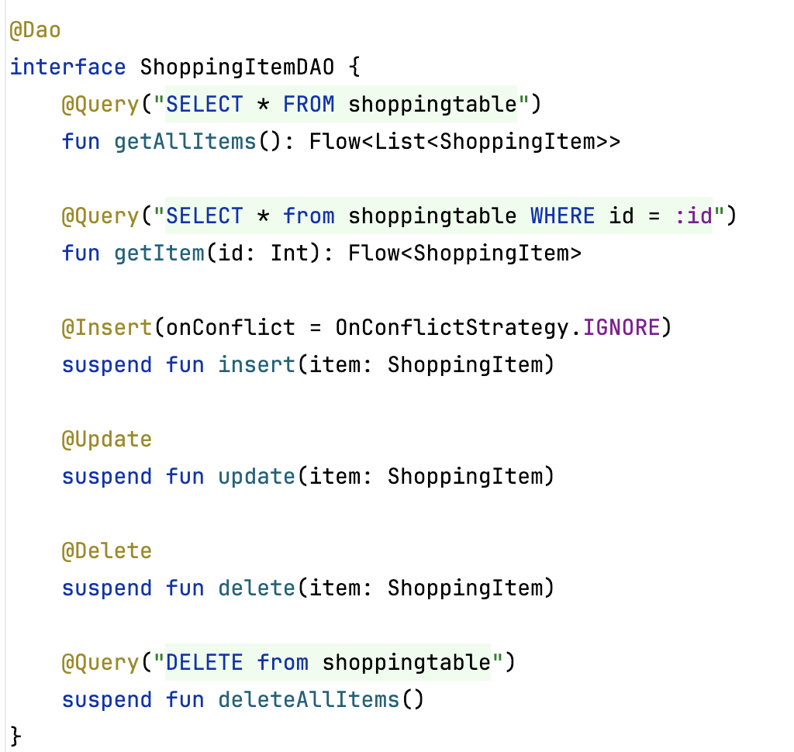
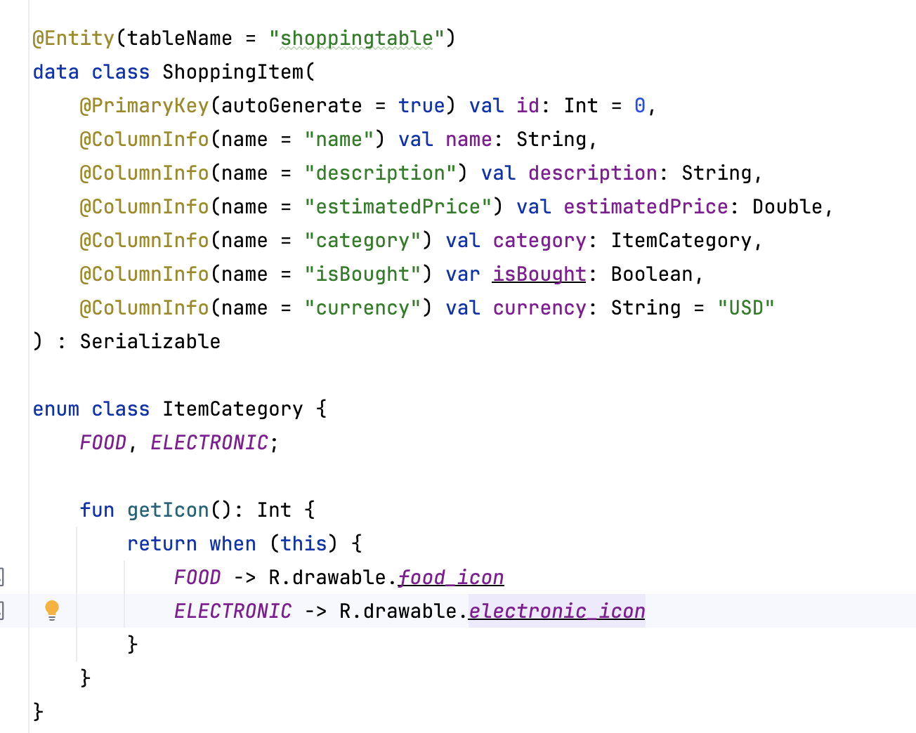
Persistence with Room
Room Database is used to store shopping list data persistently, ensuring offline access.
All CRUD (Create, Read, Update, Delete) operations are handled efficiently with Room's built-in features.
Entity: ShoppingItem (stored in shoppingtable).
- id: Auto-generated primary key.
- name: Name of the item.
- description: Detailed description.
- estimatedPrice: Price in the selected currency.
- category: Enum (FOOD, ELECTRONIC).
- currency: Default set to "USD".
Enum ItemCategory:
- Contains categories like FOOD and ELECTRONIC.
- Returns appropriate icons for each category.

Slide 7
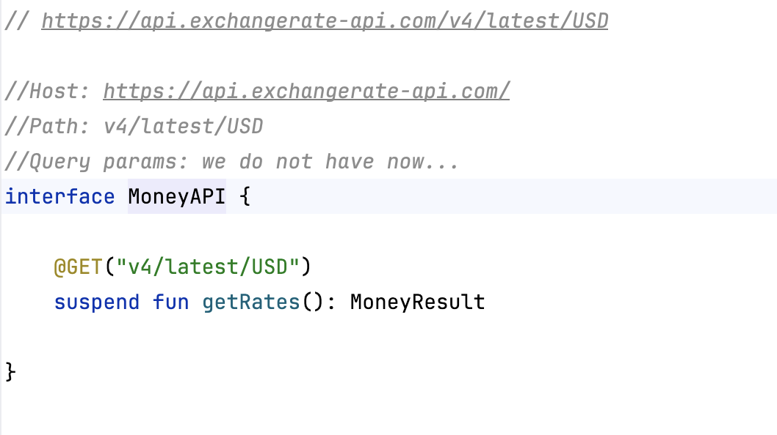
REST API Integration with Retrofit
APIs Used:
Currency Conversion API:
Purpose: Fetch real-time exchange rates for various currencies.
Usage: Convert shopping item prices to the selected currency in real time.
Retrofit Implementation:
Integration:
Defined a service interface (MoneyAPI) with API endpoints.
Used Retrofit for making asynchronous HTTP requests.
Features:
Automatic JSON serialization/deserialization using
KotlinxSerialization.

Slide 8
Broadcast Receivers
Implementation in App: Monitor network connectivity and charging state changes.
Scenarios Where They Are Triggered:
- Network Connectivity:
Detect when the device is offline and display a Toast message informing the user.
Automatically fetch real-time data (e.g., currency rates) when connectivity is restored.
- Charging State:
Display a Toast message when the device is connected to or disconnected from a charger, enhancing user awareness.

Slide 9
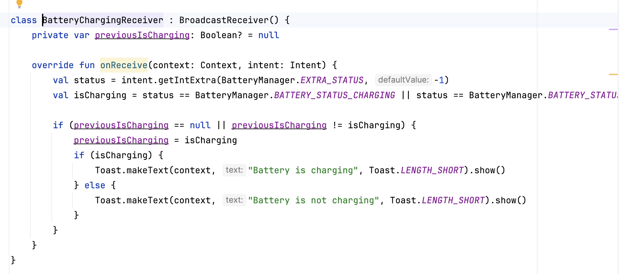
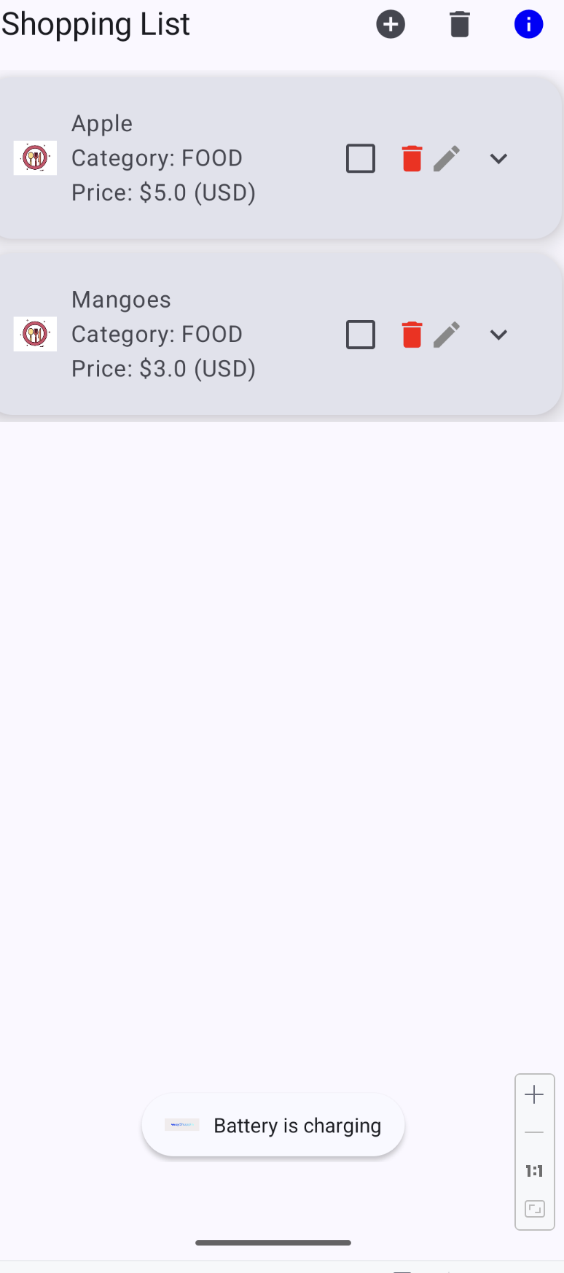
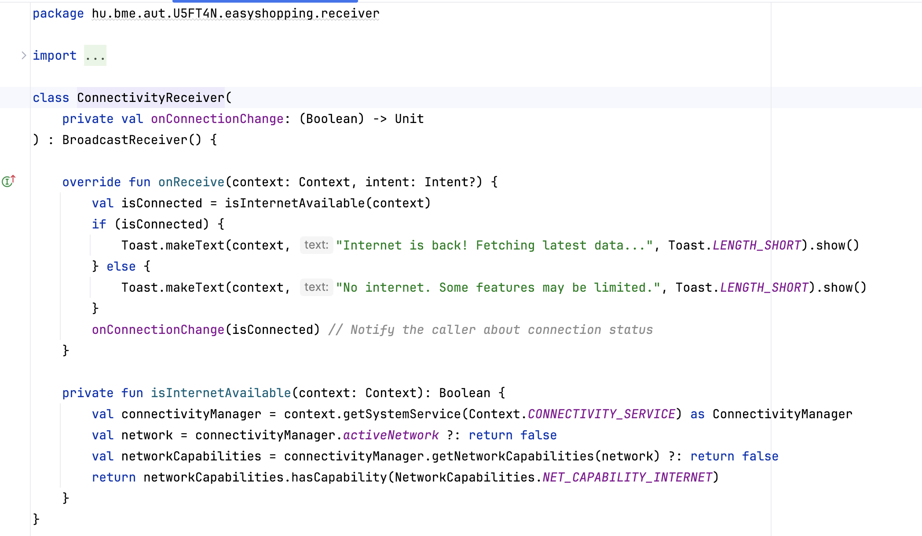

Slide 10
Challenges and Solutions
Implementing Room Database:
Challenge: Setting up the Room database schema and DAO methods was initially confusing.
Solution: Referred to a sample project to understand the structure and implemented it successfully.
Debugging REST API Integration:
Challenge: Encountered errors during API calls, which were time-consuming to debug.
Cause: Missed including a required plugin in build.gradle.kts (project-level).
Solution: Added the missing plugin, resolved the errors, and ensured proper API functionality.
Broadcast Receivers:
Challenge: None faced.
Outcome: Successfully implemented connectivity and charging state detection without issues.

Slide 11
Future Enhancements
Improved UI/UX
Additional API integrations
Use Firebase Realtime Database or Firestore for cloud storage and synchronization across devices.
Voice Commands: Integrate voice recognition to add items using voice input.
Barcode Scanning: Allow users to scan product barcodes for quick addition to the list.

Slide 12


